Slide 1
2014
Kankakee Area Career Center
Student Recognition Night

Slide 2
Welcome and
Congratulations!
Don Fay,
KACC Director

Slide 3
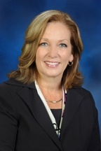
Pledge of Allegiance
State Representative
Kate Cloonen

Slide 4


Slide 5
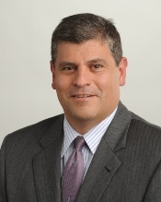
Kankakee Community College
Dr. John Avendano,
President
KACC Students Credit Hours Earned
128 702
168 967
171 837
225 1,189
157 939
1,096 5,800

Slide 6
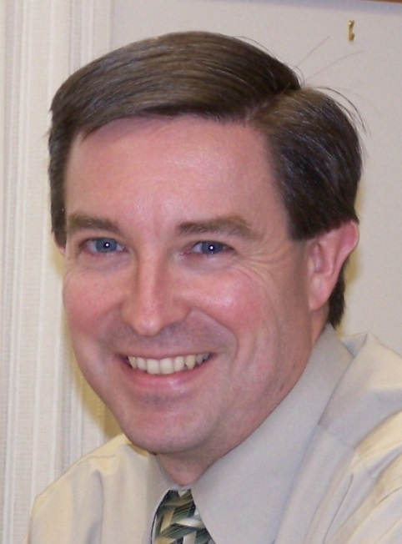
I-KAN Regional Office Of Education
Dr. Gregg Murphy
Superintendent
Frank Petkunas
Assistant Superintendent

Slide 7
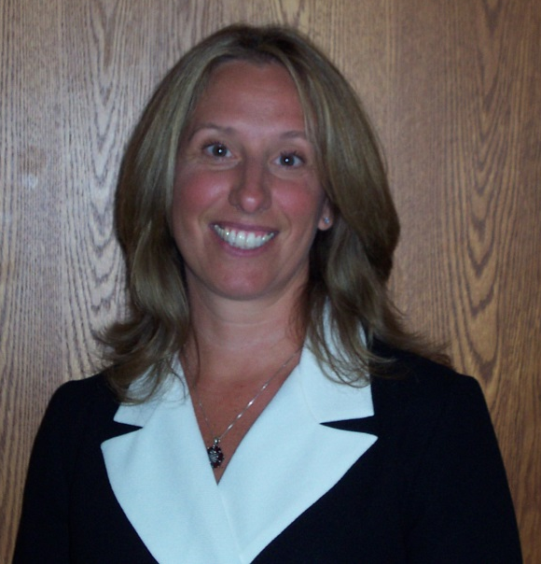
Emcees
Bosa Goodale, Principal
Matthew Kelley,
Assistant Principal

Slide 8
Scholarships
2014

Slide 9

KCC Technical Scholarship
Presented by:
Aindrea Hogan, Coordinator of Scholarships and Alumni Relations
KCC Foundation
Kankakee Community College

Slide 10

KCC Technical Scholarship
$1,000
Alejandra Orozco
Kankakee High School
Child Development/Playschool

Slide 11
BRUCE SPAULDING MEMORIAL SCHOLARSHIP
Lt. Mileen Joines,
Bourbonnais Township Fire Protection District
Denise Spaulding, Krista Campbell and Jane Lehnus

Slide 12
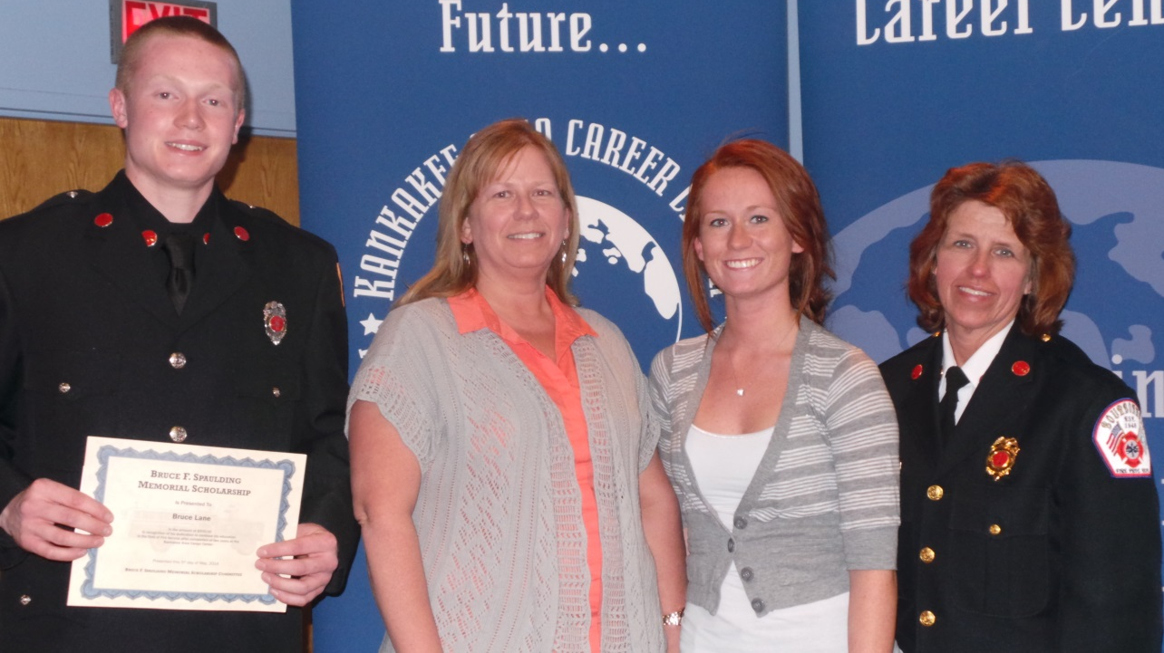
Bruce Spaulding Memorial Scholarship
BRUCE LANE, III - $500
  St. Anne High School

Slide 13
Bruce Spaulding Memorial Scholarship
Thank you to the Bourbonnais Fire Protection District, Lt. Joines, The Denise Spaulding and Jane Lehnus families.

Slide 14
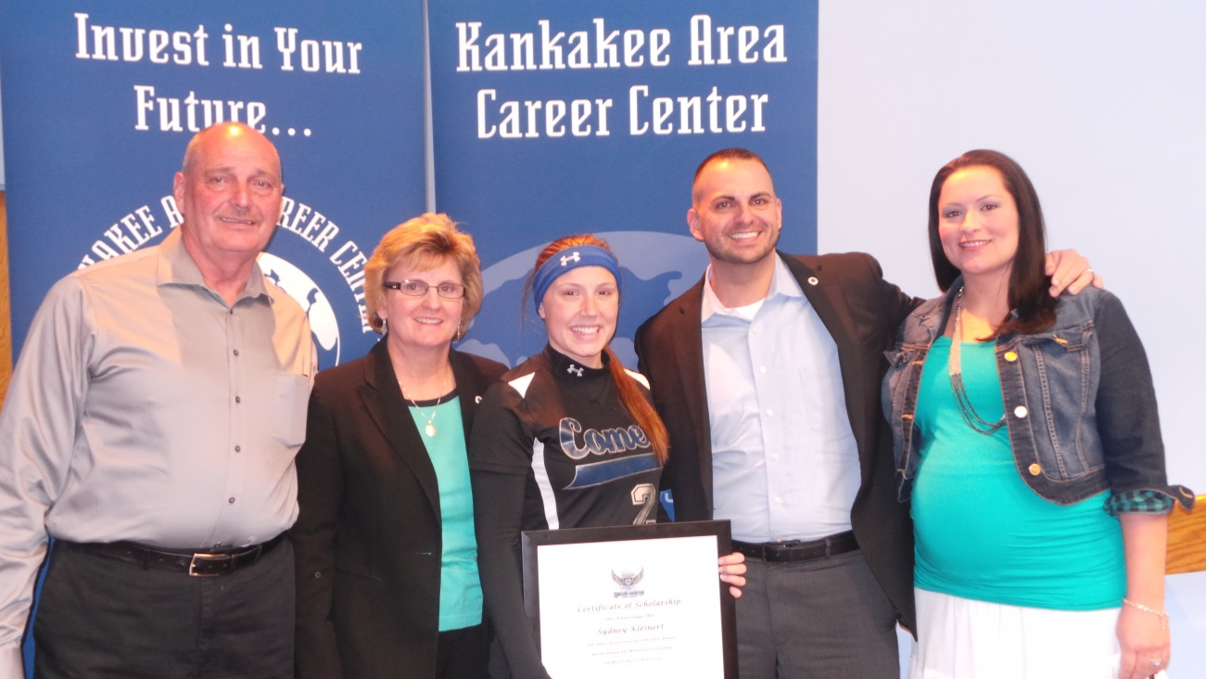
JUSTIN HONEYCUTT MEMORIAL SCHOLARSHIP
$1,000
Sydney Kleinert
Central
High School

Slide 15
KACC Learning Center Scholarships
Instructors
Michael DeBetta
Nancy Ryan

Slide 16
KACC Learning Center Scholarships
Fall Semester - $250
Nicholas Mascolo, Welding II
Herscher High School
Spring Semester - $250
Leland Fick, Welding I
Grant Park High School

Slide 17
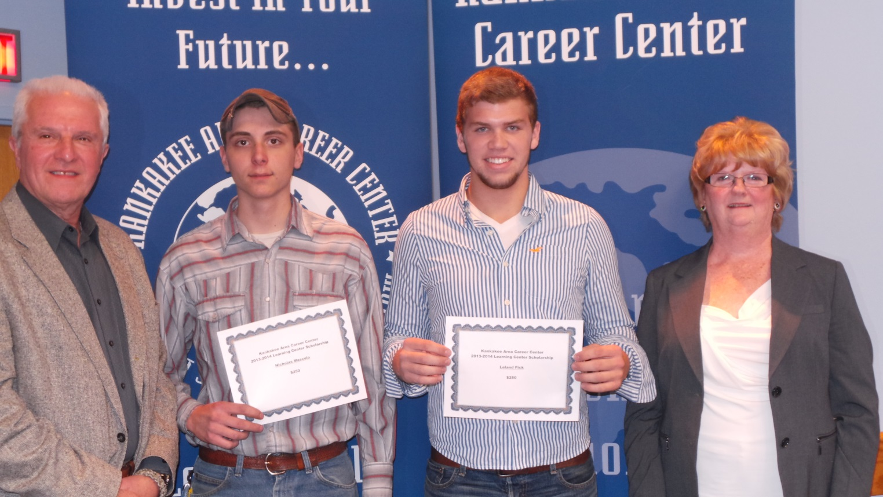
KACC Learning Center Scholarships
Mr. DeBetta, Nicholas Mascolo, Leland Fick and Mrs. Ryan

Slide 18
SkillsUSA
Champions at Work
Advisors:
Christopher Morse,
Janice Krizik and Garfield Heid

Slide 19
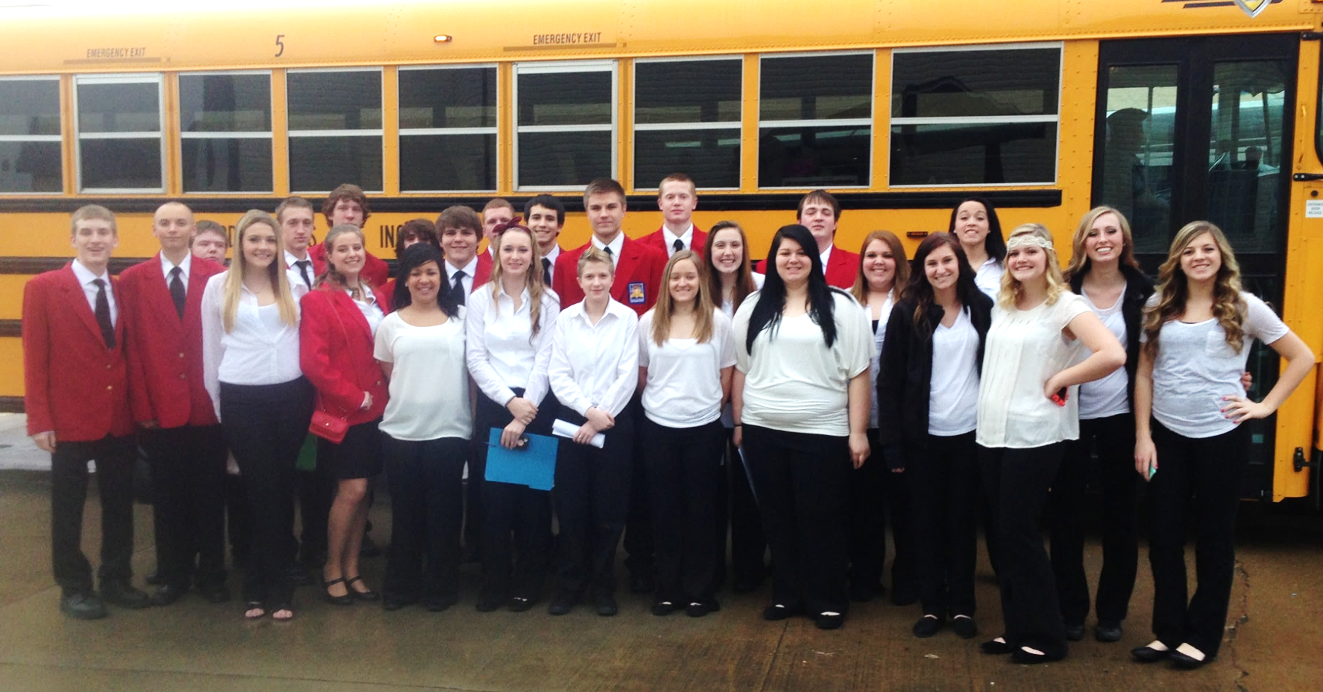
KACC Champions at State Conference

Slide 20
SkillsUSA State Results
29 students attending from KACC
15 students with “Top Ten” Ranking
3 students earned Gold or Bronze Medals
3 students have the opportunity to continue on to the National Competition in Kansas City, June, 2014

Slide 21
SkillsUSA State Winners
Fifth Place
Cosmetology – Gina Horn – Manteno H.S.
Cosmetology Model – Courtney Friedericks - Manteno
Fourth Place
Crime Scene Investigation Team #2
Stephanie Emling - BBCHS
Sydney Kleinert – Central H.S.
Mia Smith – St. Anne H.S.

Slide 22
SkillsUSA State Winners
Third Place
Fire Fighters
Bruce Lane, III - St. Anne H.S.

Slide 23
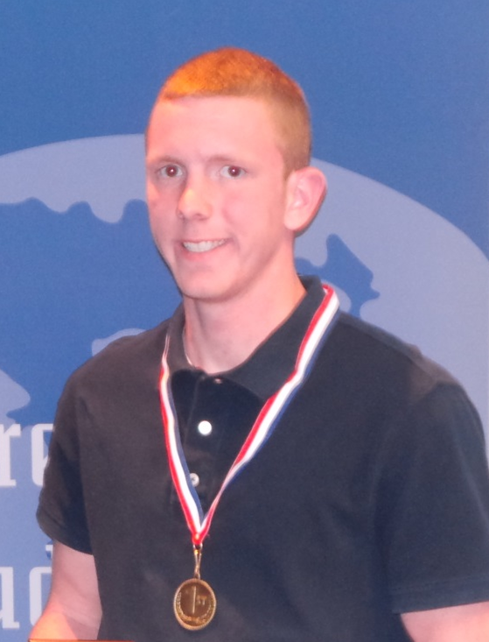
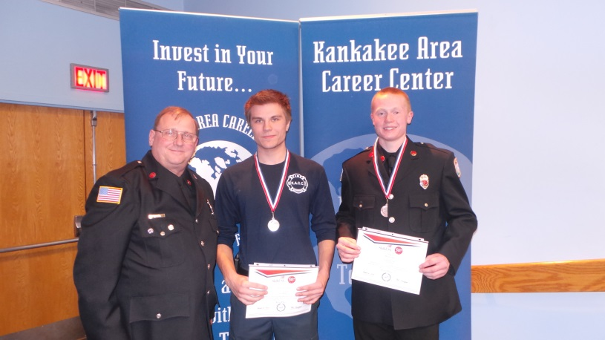
SkillsUSA
First Place Finishes
Collision Repair
Jarrad Mulderink, Beecher H.S.
Firefighters
Alexsei Zilewicz, Central H.S.

Slide 24
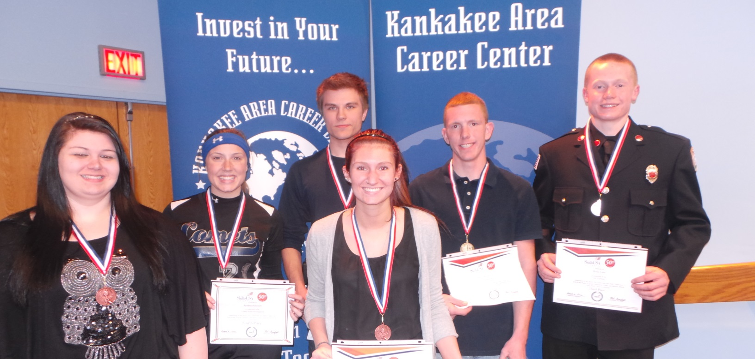
SkillsUSA State Winners
Stephanie Emling, Sydney Kleinert, Alex Zilewicz, Gina Horn, Jarrard Mulderink and Bruce Lane, III – Congratulations!

Slide 25
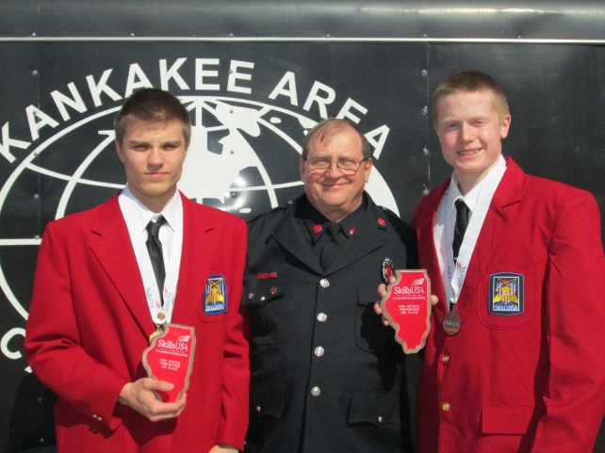
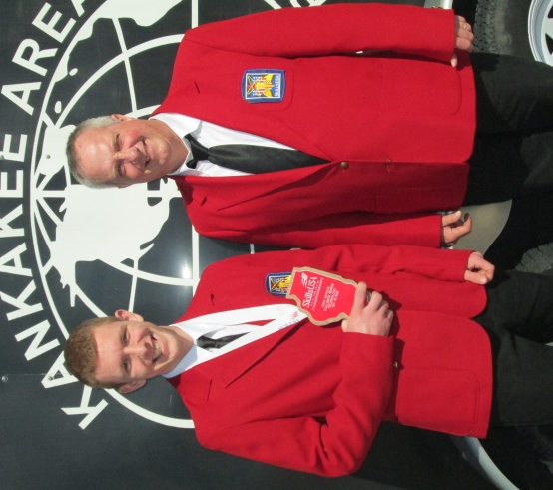
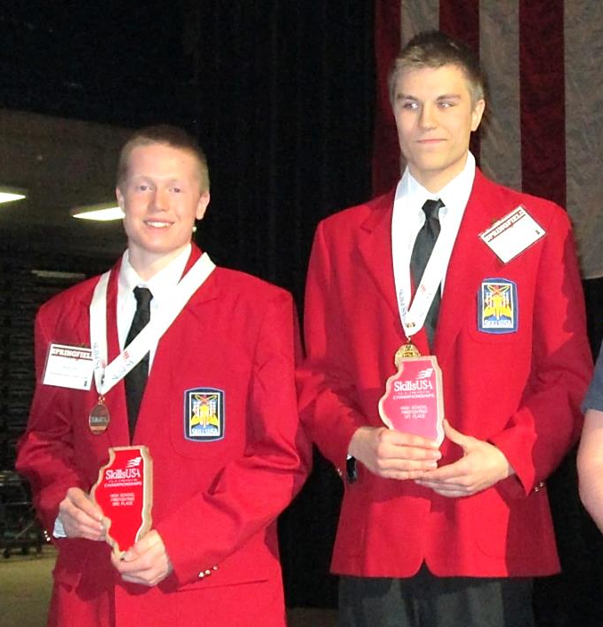
SkillsUSA – State Winners

Slide 26
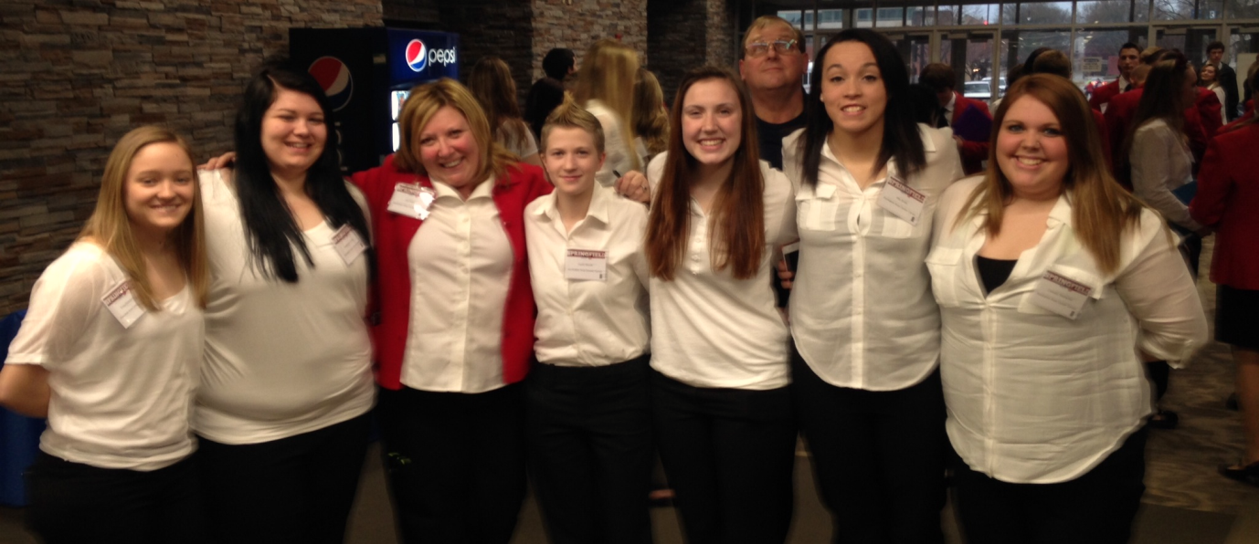
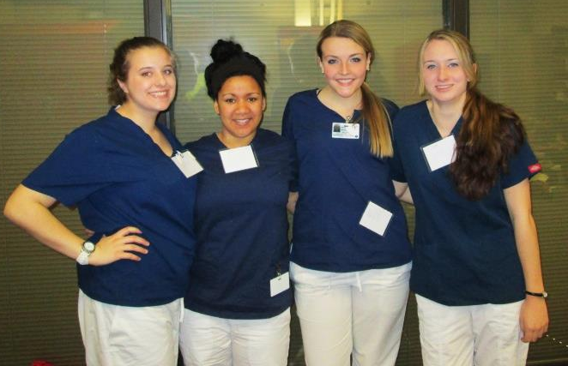
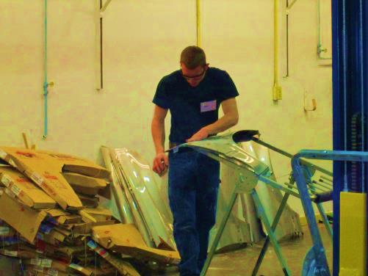

SkillsUSA!

Slide 27
Students of the Year by Course $50 Award
Presented by
KACC Instructors

Slide 28
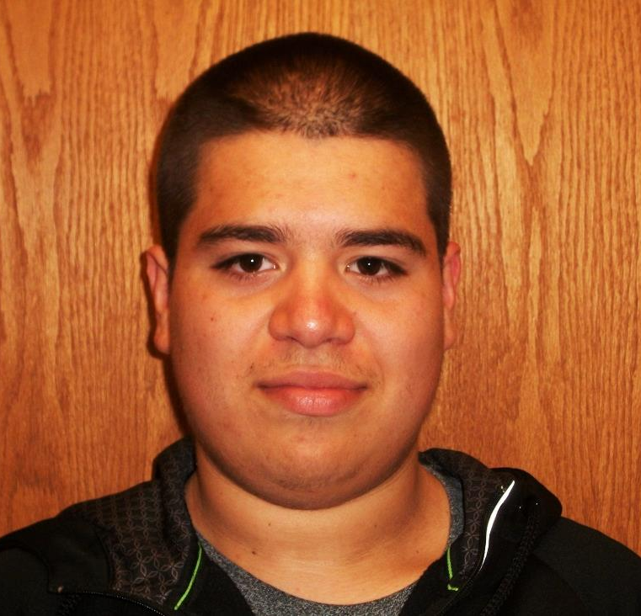
Auto Technology Bob Strand and Assistant Greg Rorabaugh
Jesus Vazquez
Bradley Bourbonnais Community H.S.

Slide 29
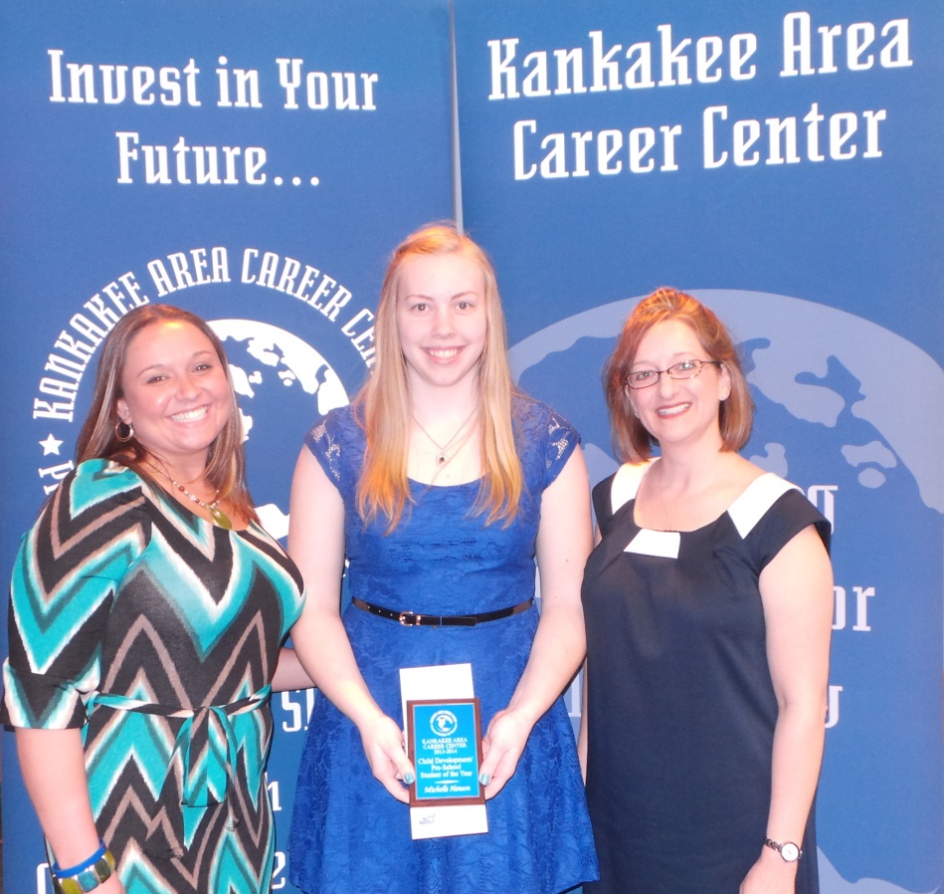
Child Development/Preschool Jennifer Leighter-Yeates
Assistant Danielle Jacques
Michelle Henson
Grant Park High School

Slide 30
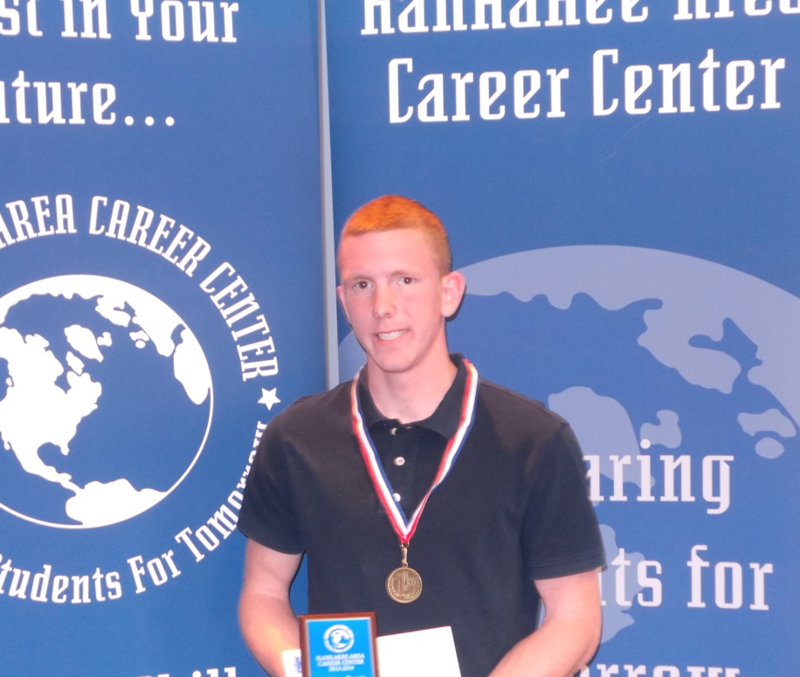
Collision Repair
Chris Morse
Jarrad Mulderink
Beecher High School

Slide 31
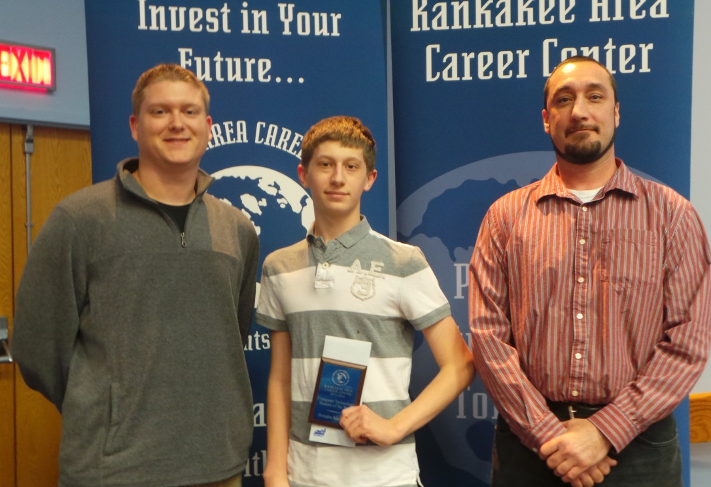
Computer Technology
Shawn Balling &
Lucas Papineau
Brenden Mancuso
Bradley Bourbonnais
Community
High School

Slide 32
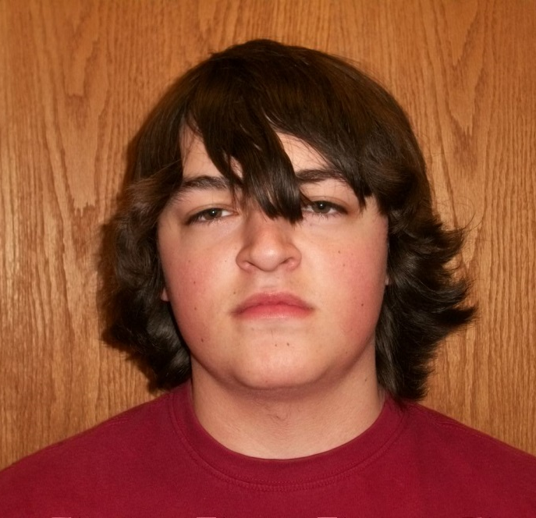
Construction Technology
Doug Enz & Jeff Umphrey
Kyle Smolkavich
Herscher High School

Slide 33
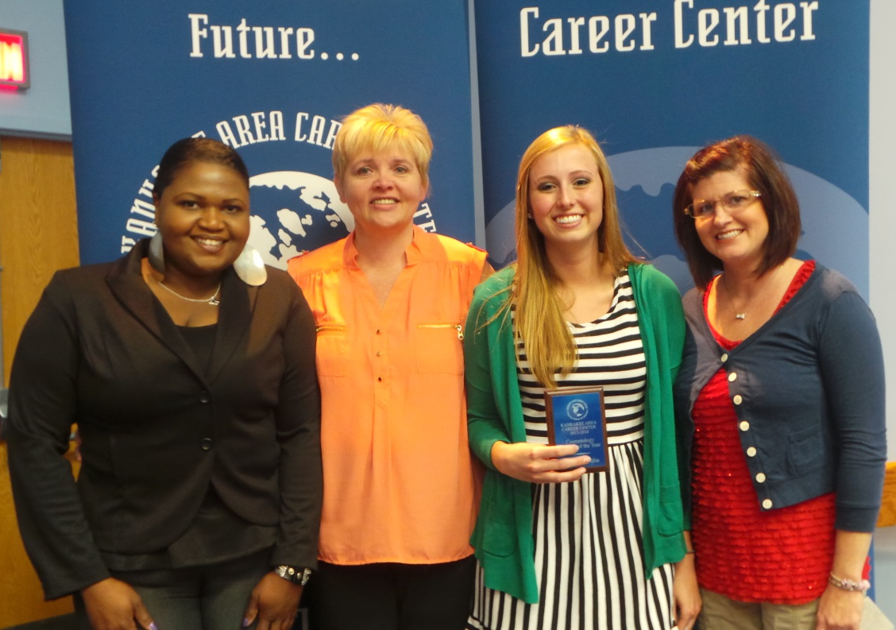
Cosmetology
Washania Jones, Rhonda Ayala, Melinda Studer
Malory Greifzu
Manteno High School

Slide 34
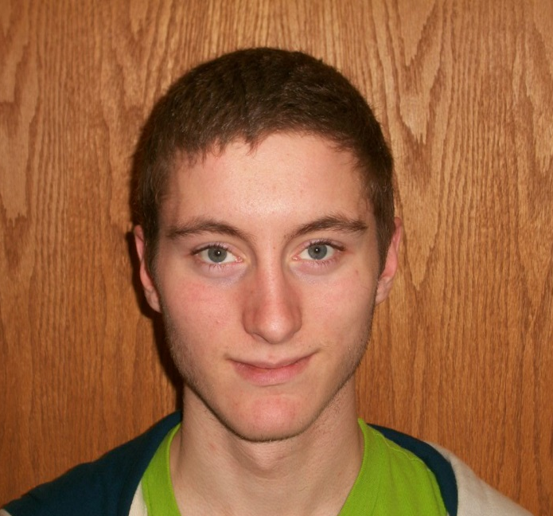
Drafting & Design
Steve Kelley
Preston Ohrt
Central High School

Slide 35
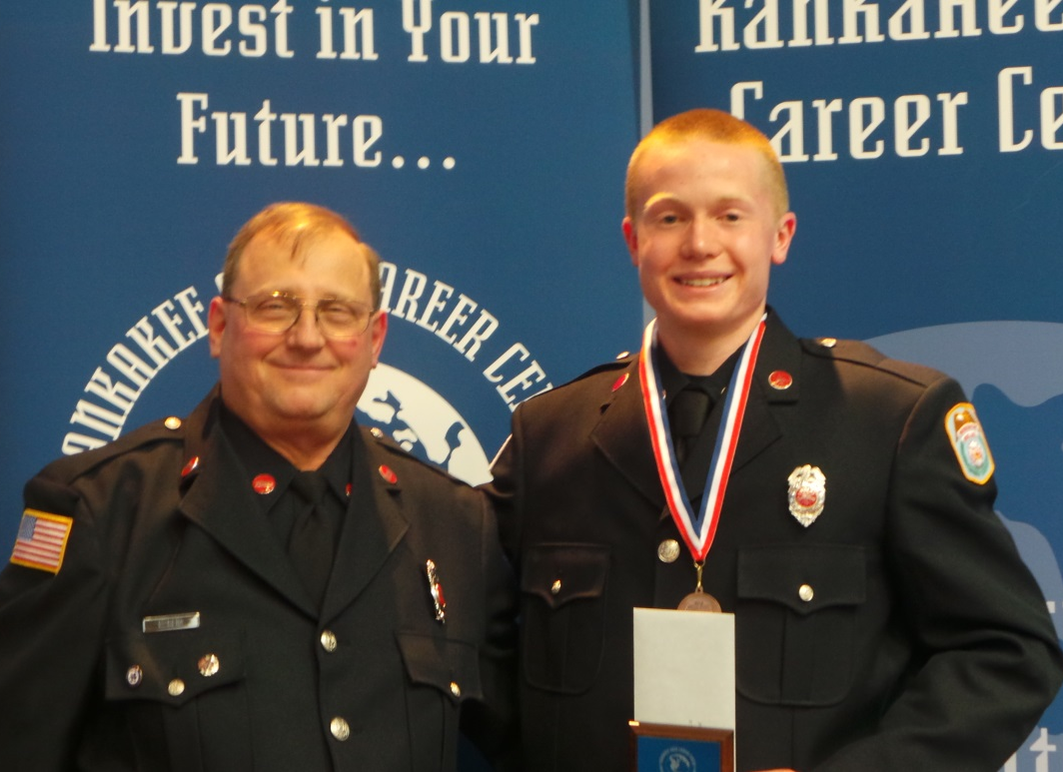
Fire/Rescue
Garfield Heid
Bruce Lane, III
St. Anne
High School

Slide 36
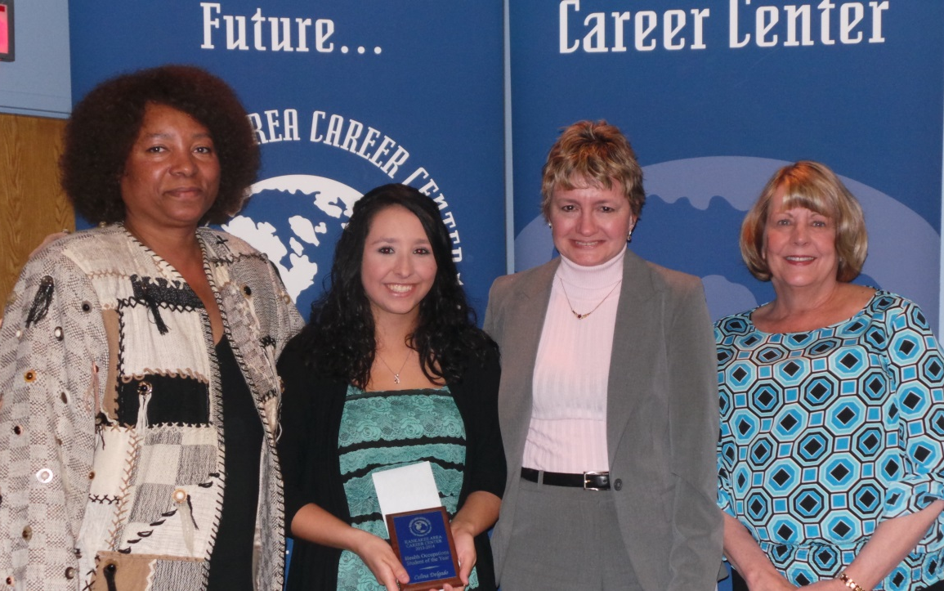
Health Occupations
Quteta Rogers,
Kaye Lemenager, Judy Krause
Celina Delgado
Herscher High School

Slide 37
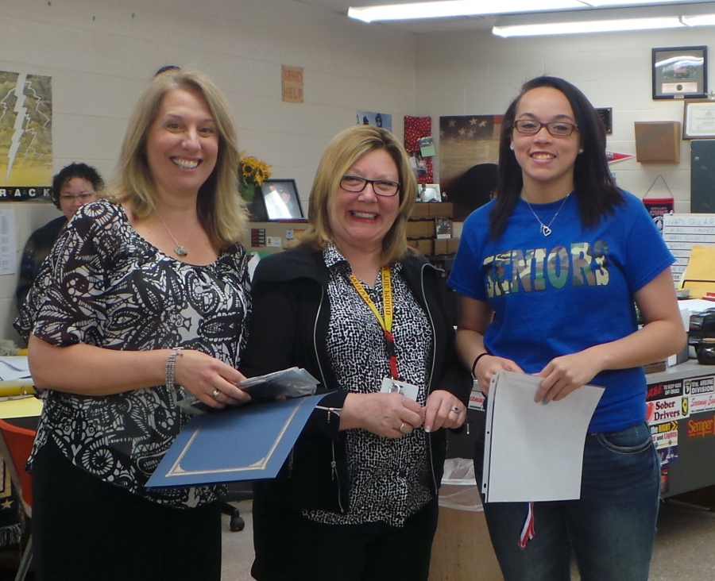
Law Enforcement Jan Krizik and Assistant Bethany Strand
Mia Smith
St. Anne High School

Slide 38
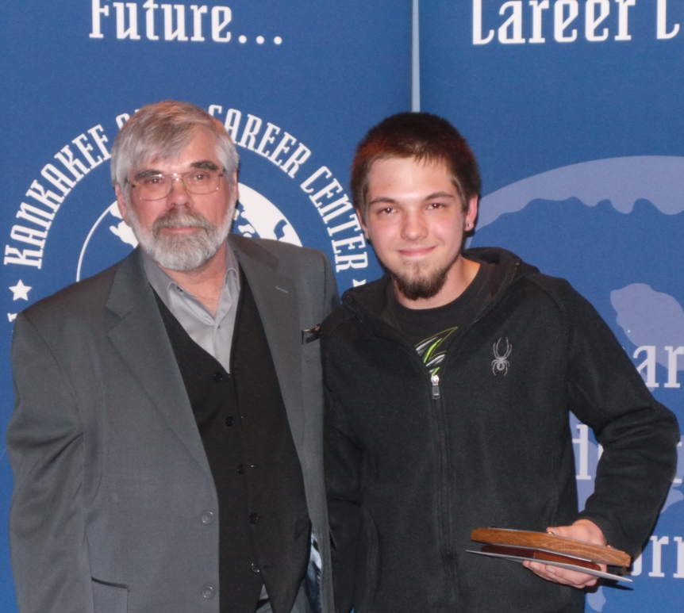
Welding Mike Spangler and Assistant Terry Erickson
Kevin Quigley
Bradley-Bourbonnais Community High School

Slide 39
Spaulding/Lawrence Memorial Scholarships
Presented by:
Donald Fay, KARVES/KACC Director

Slide 40
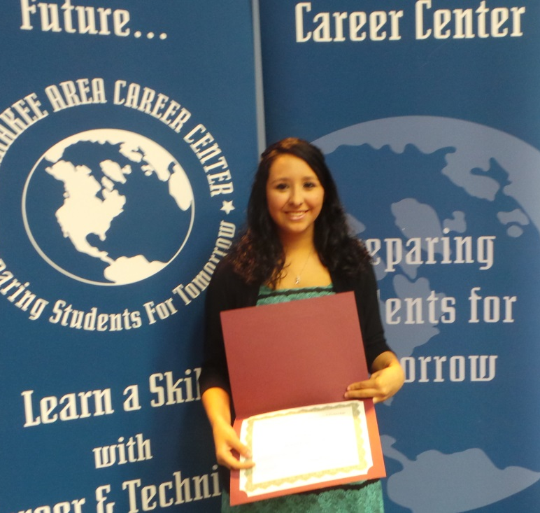
Spaulding/ Lawrence Memorial Scholarships
4th Place $250
Celina Delgado
Herscher H.S.
Health Occupations

Slide 41
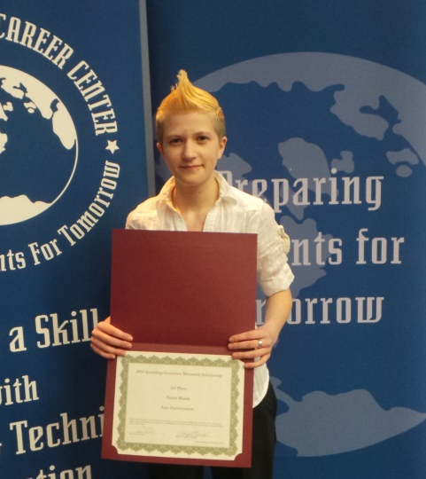
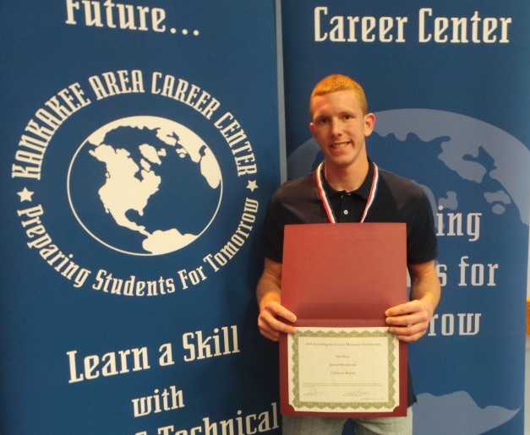
Spaulding/ Lawrence Memorial Scholarships
Taylor Bonds Central H.S. Law Enforcement
Jarrad Mulderink Beecher H.S. Collision Repair
3rd Place $500
Each

Slide 42
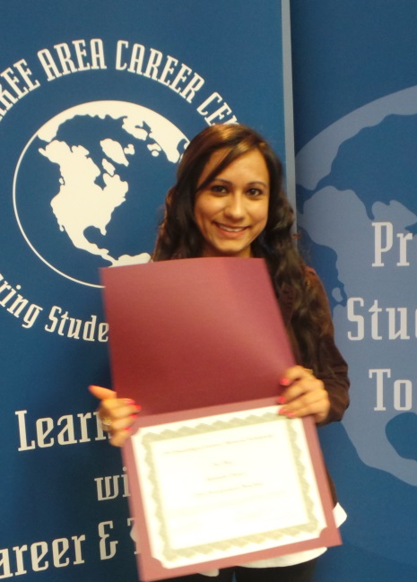
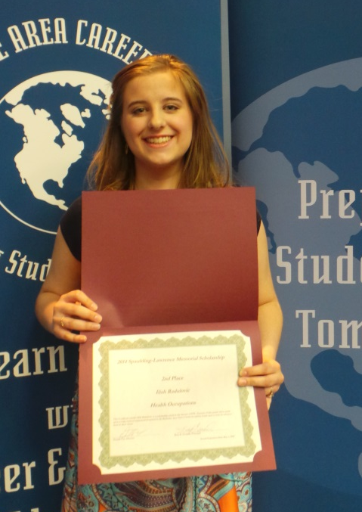
Spaulding/ Lawrence Memorial Scholarships
Alejandra Orozco Kankakee H.S. Child Dev. Preschool
Ilish Radulovic
Peotone H.S. Health Occupations
2nd Place $750 Each

Slide 43
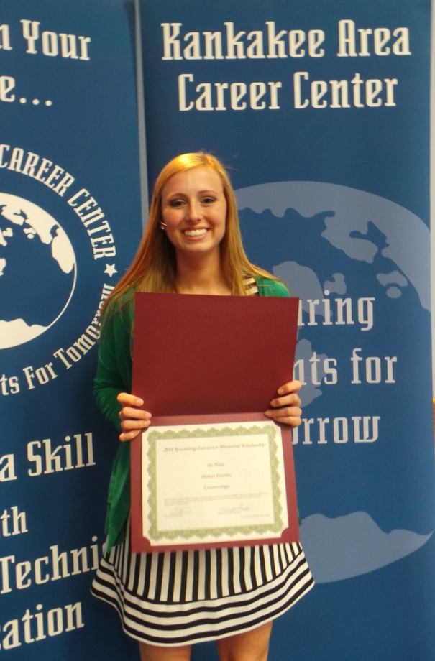
Spaulding/ Lawrence Memorial Scholarships
1st Place $1000
Malory Greifzu
Manteno H.S.
Cosmetology

Slide 44
KACC Student of the Year Awards
Presented by Principal Goodale

Slide 45
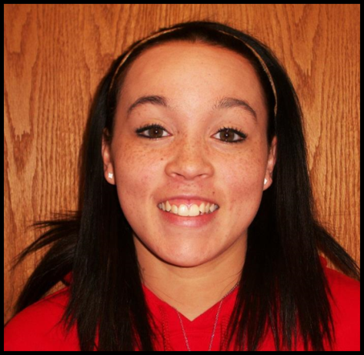
SECOND RUNNER UP
$ 350 Scholarship
Mia Smith
Law Enforcement
St. Anne H.S.

Slide 46
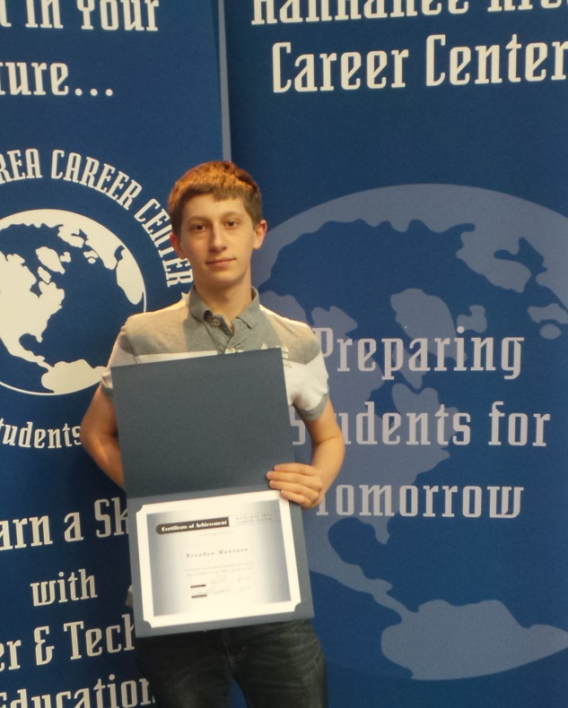
FIRST RUNNER UP
$ 700 Scholarship
Brenden Mancuso
Computer Technology
Bradley-Bourbonnais Community H.S.

Slide 47
Student of the Year 2014
$ 1,200 Scholarship

Slide 48
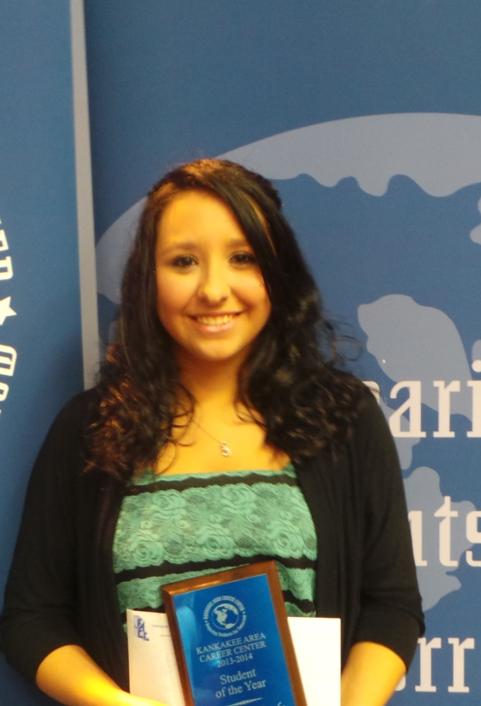
KACC 2014
Student of the Year
CELINA DELGADO
Health Occupations
Herscher H.S.

Slide 49
On behalf of the faculty and staff of the
Kankakee Area Career Center
Good Luck to all our seniors!
Please stop by and see us next year and let us know how
you’re doing!

Slide 50
Don’t Forget
Student Picnic
Friday
May 16th

Slide 51
KANKAKEE AREA
CAREER CENTER
Preparing Students for Tomorrow

